Slide 1
PDP-8 meets Python and POSIX
Curating Old Software with Modern Tools • VCF 2026
Notes:
T+0:00 — Pause while people settle. Target end: T+40:00 for Q&A.

Slide 2
Introduction
Much of vintage computing rests on “found objects”
Whatever software survived on museum-piece hardware
SIMH and emulators expanded our ability to experience these platforms
Notable active curation efforts: PiDP-10, multicians.org
Personal thread: bought a PiDP-8 kit… became a principal committer
Always with an eye toward owners of real hardware
Notes:
T+0:30 — 2 min. Set up the personal narrative early — this grounds everything that follows.

Slide 3
The Problem
Found objects: frozen in time, worn from previous use
Bitsavers preserves images…
  …but with limited provenance and history
  …and no ability to evolve
Simulator users and real hardware owners alike deserve better
We can do better
Notes:
T+2:30 — 2 min. Land on 'We can do better' with conviction.

Slide 4
The Solution: What We Can Now Do
Restoration, curation, and evolution — all three, with modern tools
Collaborate with a full suite of modern tools
Build OS/8 and other PDP-8 software from source, reproducibly
Manage packages with dependencies — automated build and test
Produce bespoke bootable media — tu56 and rk05 images
  Suitable for simulators AND museum-piece hardware
Proof it works: pdp8-alive, Adventure, and a new release today
Notes:
T+4:30 — 2 min. Emphasize: this isn't just archiving — it's a living development environment. The rest of the talk delivers on these promises.

Slide 5
The Infrastructure:
What Makes It Possible

Slide 6
Scripting Languages: The Evolutionary Arc
os8-cp → os8-run (+ os8script.py) → os8pkg → os8-progtest
Each tool built on lessons from the last
os8script.py: the shared library — Python pexpect, state machines
simh.py and os8script.py documented for future collaborators
Notes:
T+6:30 — 1 min. Frame as a learning journey. Each tool solved a problem the previous one couldn't.

Slide 7
os8-cp: The Genesis
POSIX cp semantics: colon notation for OS/8 files
Uses PIP under OS/8, pexpect under Python
The papertape hack:
  Format-convert POSIX newlines to OS/8
  Connect file to SIMH virtual papertape reader
  Pull in via PIP — works for any ASCII file
Key decision: use OS/8’s own tools rather than parse image formats directly
Parallel execution constraint: one instance per boot image
  Careful Makefile dependency management required
Co-authored with Warren Young
Notes:
T+7:30 — 2 min. The papertape hack is worth savoring — it's a great example of creative constraint-solving.

Slide 8
os8-run: Architecture
os8script.py is the library; os8-run reads and executes .os8 script files
Python pexpect drives state machines
Three execution contexts:
  SIMH context — simulator commands, device configuration
  OS/8 Keyboard Monitor — commands returning immediately to prompt
  begin/end blocks — complex sub-command dialogs, own interpreter loop
configure — scripts SIMH device changes mid-script
  TD8E vs TC08: different device drivers, almost never on same hardware
  Build for the target hardware, not just the simulator
Notes:
T+9:30 — 2 min. TD8E is a single hex-width card, CPU-driven. TC08 is DMA. Completely different OS/8 device drivers. The configure command lets us switch mid-script when building tu56 images for real hardware.

Slide 9
os8-run: begin/end Block Modes
The heart of the language’s power
cdprog — drives any program using the OS/8 Command Decoder for file specs
  ABSLDR, FOTP, and others: cycle through arbitrary file specifications
build — full BUILD dialog management
  Device driver LOAD, UNLOAD, ENABLE, DISABLE commands
  System head construction from OS8.BN and CD.BN source
enabled — block executes only if keyword is enabled
default — block executes unless keyword is disabled
  Example: skip FUTIL patches if MACREL v2 is present
version — block executes if language version meets threshold
Notes:
T+11:30 — 2 min. cdprog vs build: two fundamental ways OS/8 programs accept input. That distinction is the core problem the state machines solve.

Slide 10
os8-run: Command Vocabulary
Media management: mount, umount, boot, copy
  mount options: new, required, preserve, readonly, scratch
File transfer: cpto, cpfrom
  Newline conversion, ASCII/Binary/Image modes via PIP options
OS/8 programs: os8, pal8, ocomp
  os8: any command returning immediately to Keyboard Monitor
  pal8: assembler with richer error reporting
  ocomp: octal compare for file verification
patch — parses patch activities as published in Digital Software News
  Drives ODT or FUTIL and the Keyboard Monitor to apply them
Script control: include, enable, disable, configure, print, exit, resume, restart
Notes:
T+13:30 — 1 min. ⚡ COMPRESS if behind: talk through the groups quickly, don't read every item. Can do in 30 sec.

Slide 11
os8pkg: Full Lifecycle Package Management
.pspec files capture: format, inputs, outputs, cleanups, build instructions
Commands: deps, build, install, uninstall, verify, conflicts
.mk fragments hook into Makefile — config-time package selection
Coordinates POSIX-land and OS/8-land work
Packages include: advent, e8, cc8, uwfocal, basic-games, kermit-12
os8pkg include builds pkgs.os8 — master install script for boot image
Notes:
T+14:30 — 1.5 min. ⚡ COMPRESS if behind: hit .pspec, deps/build/install/verify, and the package list. Skip the Makefile detail. Can do in 45 sec.

Slide 12
os8-progtest: Automated Testing
yaml-defined state machines fed to Python pexpect
Program started under OS/8, commands run, results compared
--exitfirst for CI-style fail-fast behavior
Conditional logic: multiple possible responses per state
  ADVENT test handles “first run” vs. subsequent runs gracefully
War story: the BUNNY problem
  Typewriter art caused pexpect timeouts at random points
  Claude.ai spotted a regex issue — fixed with a kick state
Notes:
T+16:00 — 2 min. ✂️ SKIP BUNNY story if running behind — saves 1 min. One-liner: 'Claude.ai helped debug a regex issue in the BUNNY test — a modern tool fixing a 1970s BASIC program.'

Slide 13
Fossil: GitHub in a Box
Source code management, web display, change timeline
Wiki, issue tracker, forum, real-time chat
  Synchronous and asynchronous collaboration in one package
Single-file repository: SCM + wiki + tickets + forum + history
Mirroring is trivial — resilience against hosting failures
  If tangentsoft goes away, pdp8-alive becomes upstream instantly
  Try that with a SourceForge → GitHub migration!
Quick and easy to set up
Pro: everything backed up — one-stop shop
Con: it’s not git (Just like “It’s not Windows”?)
Notes:
T+18:00 — 2 min. The SourceForge line usually gets a laugh. Let it land.

Slide 14
Restoration:
Recovering and Rebuilding What Was

Slide 15
The Layered Build System
Ground truth: binary distribution DECtapes (.tu56) — kept read-only
Layer 1: v3d-dist.rk05 — blank rk05, BUILD customized, CUSPs copied in
Layer 2: v3d-patched.rk05 — ODT and FUTIL patches applied
Layer 3: OS8_TOOLTIME — configurable baseline (default: v3d-patched)
Layer 4: OS8_RUNTIME — packages poured in via os8pkg
Layer 5: OS/8 Combined Kit (ock) — entire stack rebuilt from source
  ock-dist.rk05 → ock-patched.rk05 → ock runtime
  Found and fixed SET TTY SCOPE bug during this work
  Latest release ships ock.rk05 as OS8_RUNTIME — fully from source!
Images suitable for simulators AND for writing to real tu56 / rk05 media
Notes:
T+20:00 — 2 min. Walk the layers top to bottom. Land hard on 'fully from source' and 'real hardware'.

Slide 16
The Patching Story: Digital Archaeology
Source: PDP-8 Digital Software News (DSN) — available on Bitsavers
Used DSN Cumulative Index (Oct/Nov 1980) to identify all relevant patches
Built a spreadsheet to track patches and actions taken
OCR’d each relevant DSN issue, compared against scanned PDFs, corrected by hand
os8script.py taught to parse the resulting patch files
  Drives ODT or FUTIL and the Keyboard Monitor to apply them
Bench-checked patches against source where available
  Marked as “verified” or “plausible” accordingly
Editorial judgment: some patches rejected, some modified
  "In later years, patches became less carefully produced…"
  "Some are not correctable, even today."
Notes:
T+22:00 — 1.5 min. This is detective work. Emphasize the judgment calls — not just applying patches blindly.

Slide 17
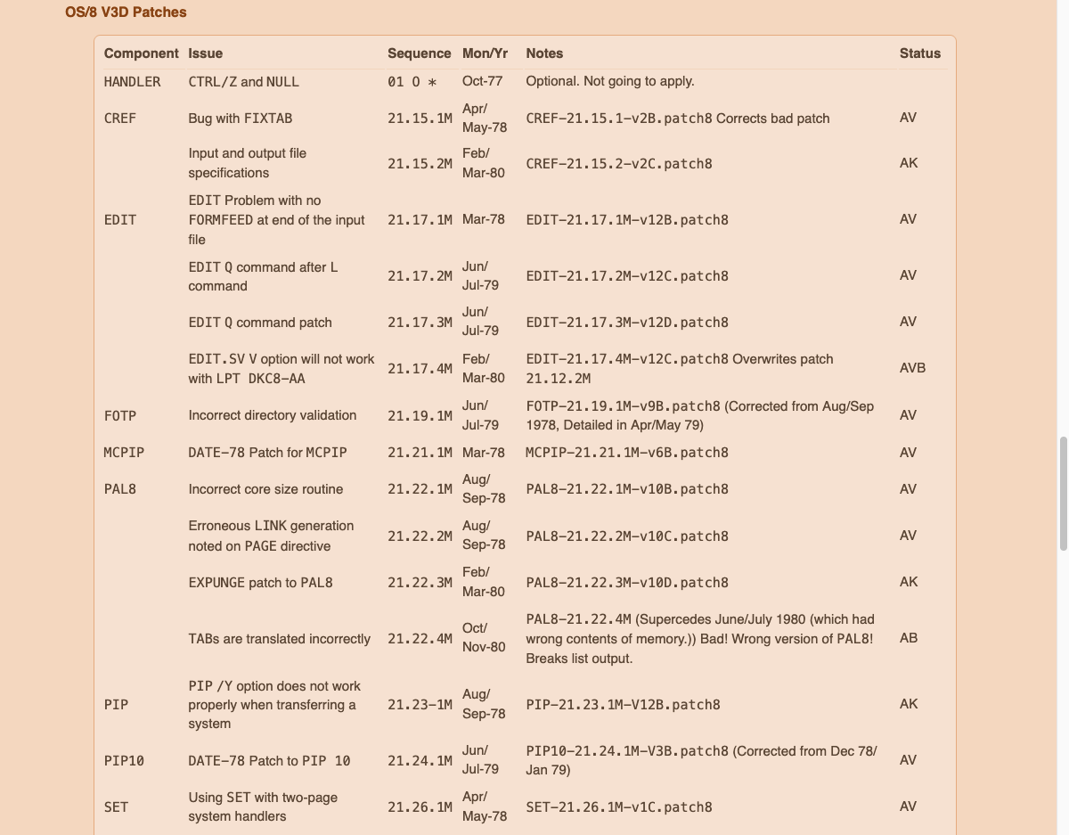
The Patching Story: Spreadsheet
Component, Issue, Sequence, Date, Notes — and editorial Status for every patch reviewed
Notes:
T+23:30 — 30 sec. Point out Status column: AV=applied/verified, AK=applied/plausible, AB=applied/broken, O=omitted. Note 'Bad! Wrong version of PAL8! Breaks list output.' — DEC's own patches had bugs.

Slide 18
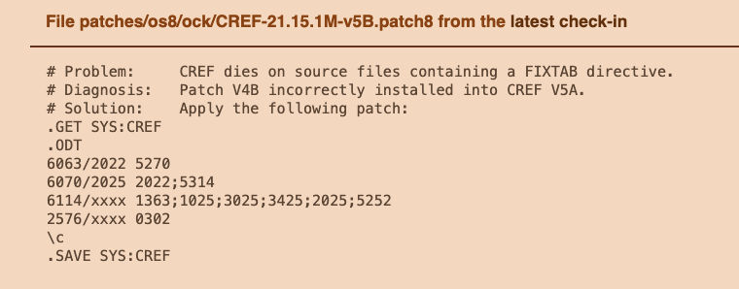
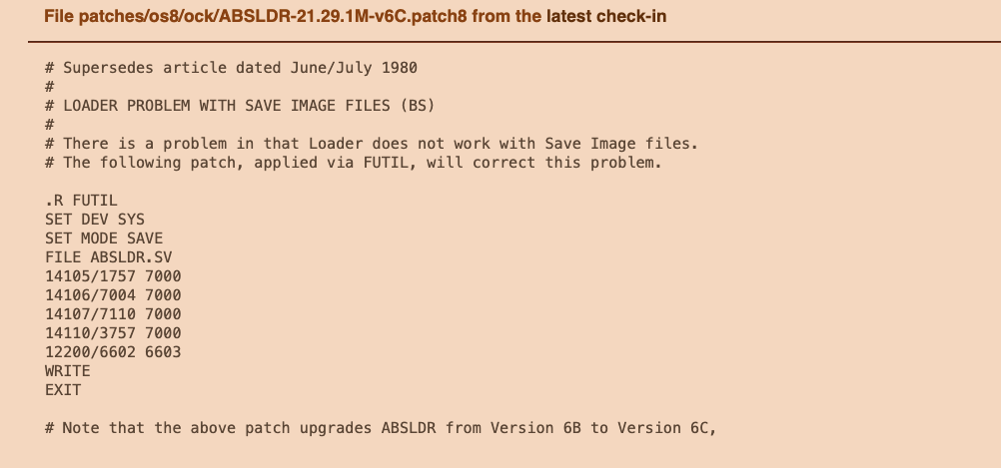
Patch Files: Two Formats, One Parser
ODT format
FUTIL format
os8script.py parses both formats — driving ODT or FUTIL and the Keyboard Monitor to apply each patch
Notes:
T+24:00 — 1 min. Fossil file header visible at top of each — under source control. ODT: terse address/old/new triplets. FUTIL: higher-level file-oriented commands. Same parser handles both.

Slide 19
DEMO
BUILD Log Walkthrough
[ DEMO: Walk through os8-run BUILD log
showing state machine transitions ]
Notes:
T+25:00 — 2 min. ✂️ SKIP if behind — say: 'I'll show the BUILD log in Q&A for anyone interested.'
PREP (before talk):
mv bin/ock.rk05 bin/ock.rk05.preserve
bin/os8-run -v scripts/os8/ock/dist-rk05.os8
DEMO:
less obj/os8-script.log
Walk through key state machine transitions:
- SIMH boot sequence
- BUILD configuration commands
- FETCH of OS8.BN and CD.BN
- BOOT and SAVE sequence
Keep tight — this is 'how' not 'what'.

Slide 20
Curation:
Provenance, History, and Collaboration

Slide 21
DEMO
Fossil Collaboration Environment
[ DEMO: https://tangentsoft.com/pidp8i/ ]
Notes:
T+27:00 — 3 min. ⚡ COMPRESS: screenshots only if no wifi or running behind — saves 1 min.
URL: https://tangentsoft.com/pidp8i/
Visit in this order:
☐ Home — project overview, current release
☐ Wiki — documentation, how-to guides
☐ Bugs — issue tracker
☐ Wishes — feature requests (note the friendlier name!)
☐ Forum — community discussion
☐ Files — source tree
☐ Timeline — change history
☐ Diff display — show a recent change rendered

Slide 22
pdp8-alive: Proof of Concept
Fossil-based curation environment at poetnerd.com
Three repositories: advent.fossil, image-test.fossil, pdp8-alive.fossil
Demonstrates the full collaboration stack in action
PDP-8 Adventure as the proof of concept for active curation
If tangentsoft ever goes away — pdp8-alive is ready to become upstream
Notes:
T+30:00 — 1 min.

Slide 23
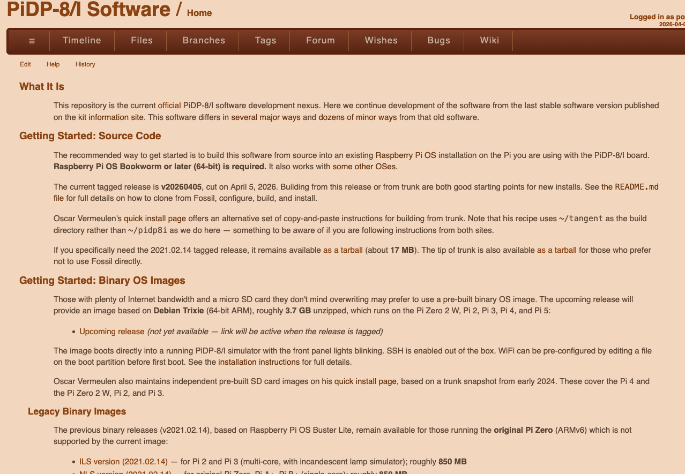
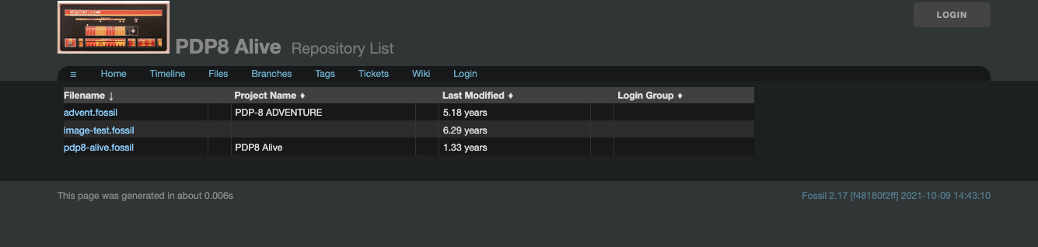
Fossil: Two Skins, Same Platform
pdp8-alive at poetnerd.com
tangentsoft.com
Same Fossil platform — two configured skins. The animated PiDP-8 front panel shows bits shifting through the AC!
Notes:
T+31:00 — 30 sec. Point out identical nav structure despite very different styling. Animated front panel is a crowd pleaser — mention it!

Slide 24
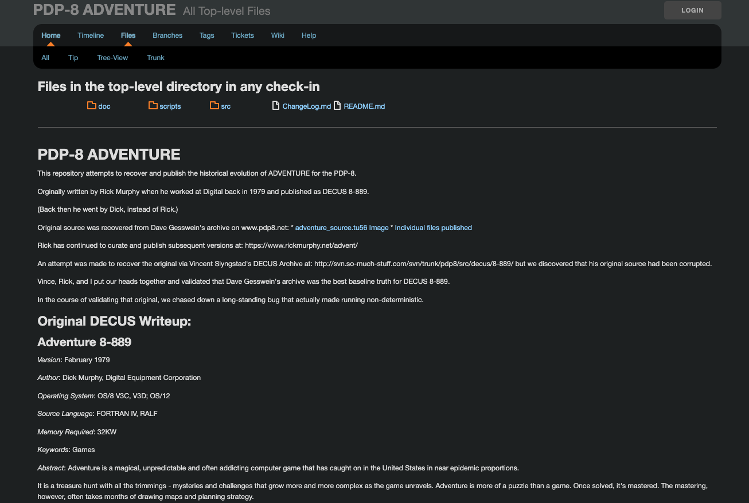
PDP-8 Adventure: Curation in Fossil
Notes:
T+31:30 — 1 min. Point out: README as project home, provenance narrative, detective work (multiple sources checked, corruption found), 'Vince, Rick, and I put our heads together'. The curation story is right there in the text.

Slide 25
PDP-8 Adventure: End-to-End Curation
Originally written by Dick Murphy (later: Rick) at DEC, 1979
Published as DECUS 8-889 — February 1979
Source recovery: Gesswein archive, Rick’s website, Slyngstad DECUS archive
  Slyngstad’s copy found to be corrupted — collaborative validation
  Wayback Machine used to date the 2007 release
17 check-ins: 1979 → 2021 — the full historical arc
Reconstructed versions with honest uncertainty:
  “Creation date of March 1, 2009 is a rough guess”
  “Does not run. Complains of needing more core” — dead ends documented
The bug: non-deterministic startup — present since 1979
  Fixed collaboratively: wdc + rick, January 2021
Notes:
T+32:30 — 1.5 min. This is the emotional heart. Let the detective story breathe.

Slide 26
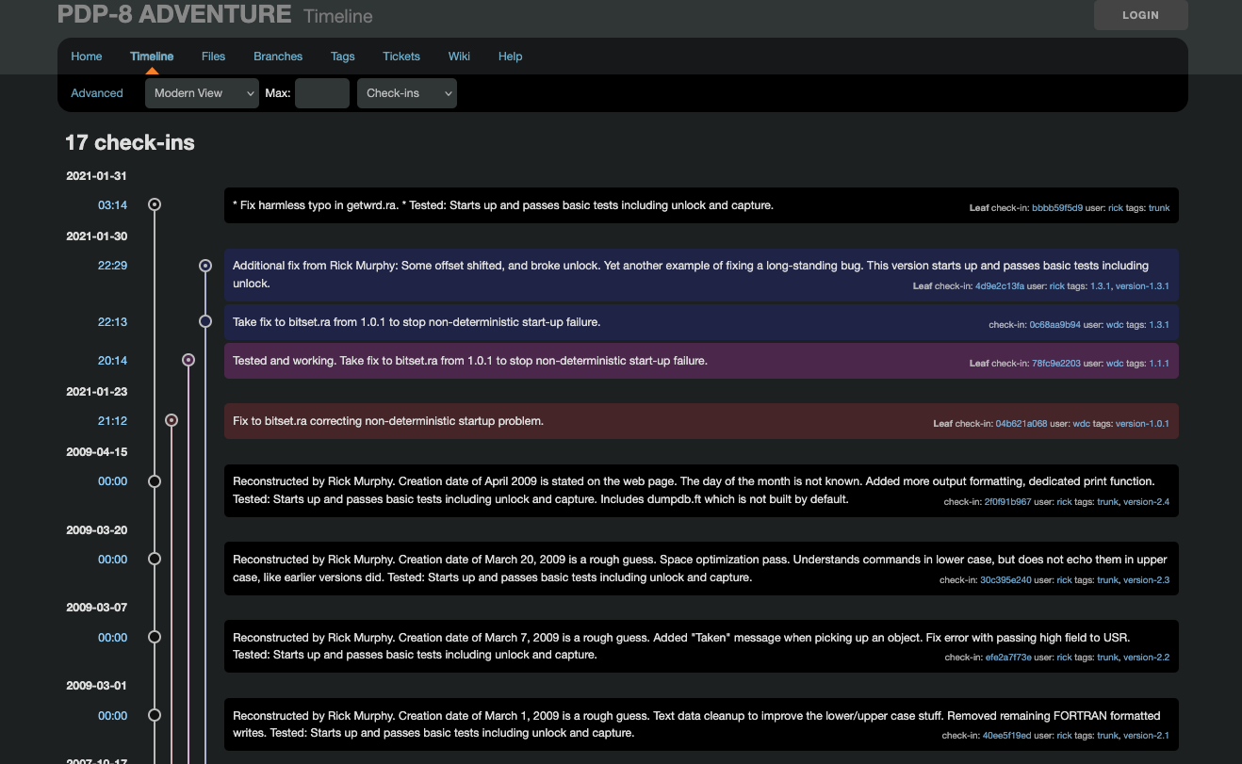
Adventure Timeline: The Bug Fix (2021)
17 check-ins — collaborative fix of a non-deterministic startup bug, January 2021
Notes:
T+34:00 — 1 min. PROTECT THIS TIME. Two contributors (wdc and rick), back-and-forth on consecutive days, version tags. The collaboration is literally in the record.

Slide 27
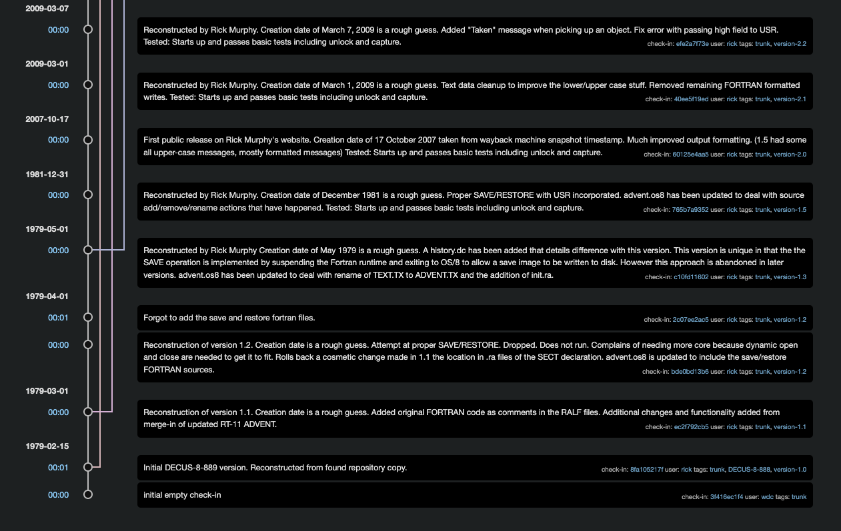
Adventure Timeline: Back to 1979
From reconstructed 1979 originals to 2009 Wayback Machine recovery — curation with honest uncertainty
Notes:
T+35:00 — 1 min. PROTECT THIS TIME. Point out: v1.2 'Does not run. Complains of needing more core' — dead ends documented honestly. Wayback Machine timestamp for 2007. 'Forgot to add the save and restore fortran files' — a commit message from 1979, reconstructed in 2021.

Slide 28
Evolution:
New Capabilities That Didn’t Exist Before

Slide 29
Evolution: Delivered
This isn’t just preservation — it’s a living development environment
cc8 — rudimentary C compiler for the PDP-8
e8 — micro emacs: screen editor like nano, no run-time language
U/W FOCAL on non-EAE hardware — recovery with a twist
  Missing module reconstructed with AI assistance
  Claude.ai proved far better suited for this than ChatGPT
  Additional sources: Vincent Slyngstad’s repository
Adventure: built from source as a managed os8pkg package
OS/8 Combined Kit: now shipping as fully source-built OS8_RUNTIME
All producing bootable media suitable for real hardware
Notes:
T+36:00 — 1.5 min. Optional: mention cc8 retargeting story (assembler orphaned, learned to retarget a C compiler over a weekend — before AI). Only if time permits.

Slide 30
DEMO
make test
[ DEMO: Live or recorded
Packages selected at config time
make test output — all tests passing
ADVENT smoke test ]
Notes:
T+37:30 — 2 min. ✂️ LIKELY SKIP — say: 'make test runs automatically. All tests pass, including ADVENT. Happy to show this in Q&A.'
If including:
Show make log fragment: packages selected, 'We can test:'
Run make test (live or recorded)
Let 'Test Passes' lines land one by one
Pause on ADVENT smoke test — Python state machines testing 1960s software
⚡ COMPRESS: show recorded output only, skip preamble — saves 30 sec.

Slide 31
The Future

Slide 32
The Future
Next Steps
Project Ideas
Booting new media on museum-piece hardware
  Toolchain already produces the right images
  Getting them onto real media is the remaining step
More collaborators
SIMH contributions in progress
Music support in SIMH
vc8e support
Family of 8 support to SIMH
The definitive history of FOCAL
Notes:
T+39:30 — 1 min. Project Ideas are an open invitation — read them as things waiting for someone in the room to pick up.

Slide 33
Conclusion

Slide 34
Conclusion
The infrastructure exists. The methodology works.
Build bespoke bootable media — from source, managed, tested
  Suitable for simulators and museum-piece hardware alike
Restoration, curation, and evolution — all possible with modern tools
Not PDP-8 specific — this approach can inspire similar work elsewhere
Come collaborate with us:
  https://tangentsoft.com/pidp8i/wiki?name=Home
Notes:
T+40:30 — 1 min. Land the last bullet with an open invitation. Pause before Special Thanks.

Slide 35
Special Thanks
Oscar Vermeulen — Creating the PiDP-8i, initial inspiration
Warren Young — Initial primary committer, Fossil mentor, co-author of os8-cp
Rick Murphy — Ported RT-11 Adventure to PDP-8, critical to POC curation, co-fixed the bug
Vincent Slyngstad — Archives and collaboration on Adventure and FOCAL
Steve Tockey — Cycle-accurate code for SIMH
HB Eggenstein — Incandescent Light Simulation (making LEDs look like light bulbs)
Bill Silver — Wrote e8
Ian Schofield — Wrote cc8
Current collaborators
Notes:
T+41:30 — 30 sec. Read the names. Optional cc8 story: assembler became orphaned; Ian learned to retarget a C compiler over a weekend — before AI assistance existed.

Slide 36
Q & A
https://tangentsoft.com/pidp8i/wiki?name=Home
Notes:
T+42:00 — Q&A.
Good Q&A topics to have ready:
- BUILD log demo (if skipped)
- make test demo (if skipped)
- How to get started contributing
- The race condition / parallel make bug currently being chased
- FOCAL history details
- The cc8 assembler retargeting story

